Slide 1
Principles of Data Science
Li Niu

Slide 2
Correlation
Causation

Slide 3
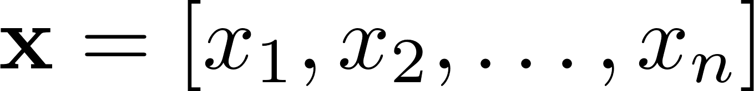
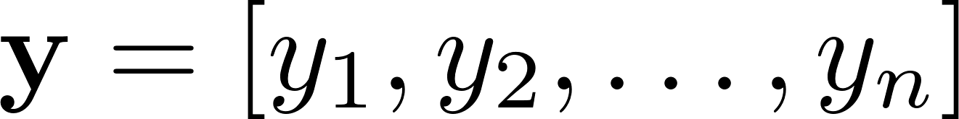
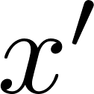
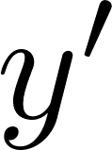

Occurrence
How many times and co-occur in

Slide 4
Frequent pattern
Tid | Items bought
10 | Beer, Nuts, Diaper
20 | Beer, Coffee, Diaper
30 | Beer, Diaper, Eggs
40 | Nuts, Eggs, Milk
50 | Nuts, Coffee, Diaper, Eggs, Milk
Itemset: A set of one or more items
Support of X: Frequency or occurrence of an itemset X
An itemset X is frequent if X’s support is no smaller than a given threshold

Slide 5
Frequent pattern
Tid | Items bought
10 | Beer, Nuts, Diaper
20 | Beer, Coffee, Diaper
30 | Beer, Diaper, Eggs
40 | Nuts, Eggs, Milk
50 | Nuts, Coffee, Diaper, Eggs, Milk
Any subset of a frequent itemset must be frequent:
If {beer, diaper, nuts} is frequent, so is {beer, diaper}, because every transaction having {beer, diaper, nuts} also contains {beer, diaper}

Slide 6
Apriori algorithm
Initialize k=1 and candidate 1-itemsets.
Repeat until no frequent set can be generated:
1. Scan database to get frequent k-itemsets
based on candidate k-itemsets.
2. Generate candidate (k+1)-itemsets
from frequent k-itemsets.
3. k=k+1

Slide 7
Apriori algorithm
threshold = 2
Database
Candidate 1-itemset
Frequent 1-itemset
Itemset | sup
{A} | 2
{B} | 3
{C} | 3
{D} | 1
{E} | 3
Tid | Items
10 | A, C, D
20 | B, C, E
30 | A, B, C, E
40 | B, E
Itemset | sup
{A} | 2
{B} | 3
{C} | 3
{E} | 3
1st scan

Slide 8
Apriori algorithm
threshold = 2
Frequent 1-itemset
Candidate 2-itemset
Itemset
{A, B}
{A, C}
{A, E}
{B, C}
{B, E}
{C, E}
Itemset | sup
{A} | 2
{B} | 3
{C} | 3
{E} | 3

Slide 9
Apriori algorithm
threshold = 2
Database
Candidate 2-itemset
Frequent 2-itemset
Tid | Items
10 | A, C, D
20 | B, C, E
30 | A, B, C, E
40 | B, E
Itemset | sup
{A, B} | 1
{A, C} | 2
{A, E} | 1
{B, C} | 2
{B, E} | 3
{C, E} | 2
2nd scan
Itemset | sup
{A, C} | 2
{B, C} | 2
{B, E} | 3
{C, E} | 2

Slide 10
Apriori algorithm
threshold = 2
Frequent 2-itemset
Candidate 3-itemset
Itemset | sup
{A, C} | 2
{B, C} | 2
{B, E} | 3
{C, E} | 2
Itemset
{B, C, E}

Slide 11
Apriori algorithm
threshold = 2
Database
Candidate 3-itemset
Frequent 3-itemset
Tid | Items
10 | A, C, D
20 | B, C, E
30 | A, B, C, E
40 | B, E
3rd scan
Itemset | sup
{B, C, E} | 2
Itemset | sup
{B, C, E} | 2

Slide 12
Question
Tid | Items bought
10 | Beer, Diaper, Egg
20 | Coffee, Diaper, Milk
30 | Beer, Coffee, Diaper, Milk
40 | Coffee, Milk
Find all frequent sets with threshold=2

Slide 13
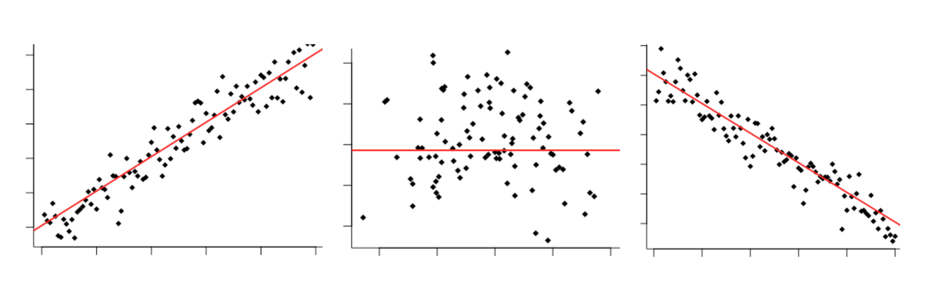


Correlation
positive correlation
no correlation
negative correlation
grade
grade
grade
study time
body weight
game time

Slide 14
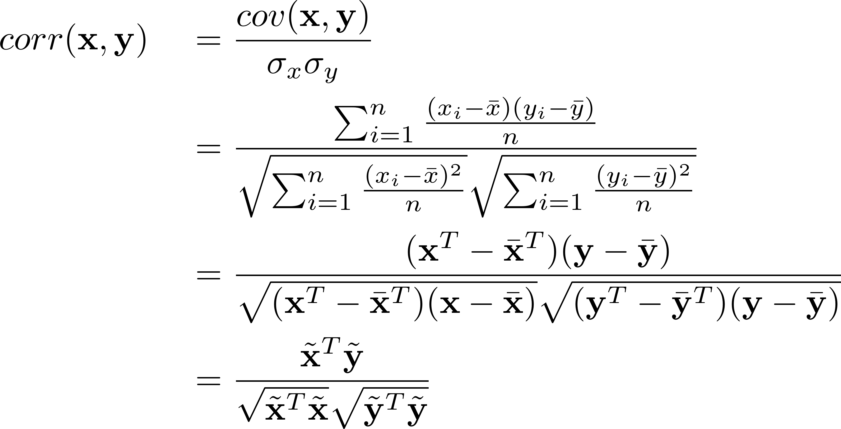
Correlation
covariance

Slide 15
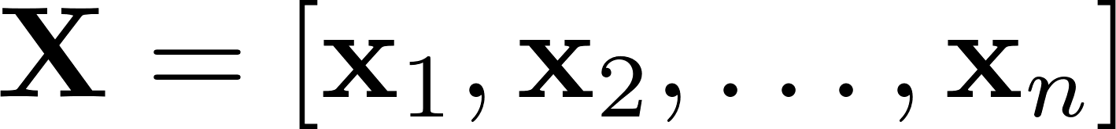
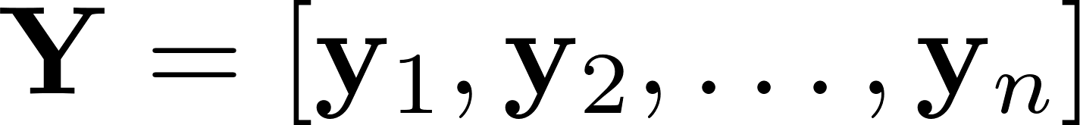
Correlation
What if each sample is a vector instead of a scalar?

Slide 16


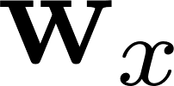
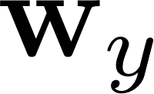
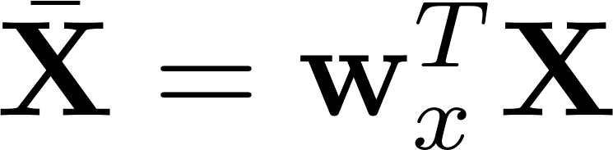
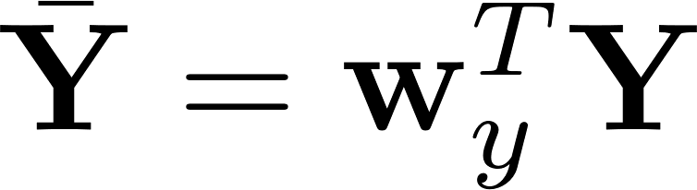
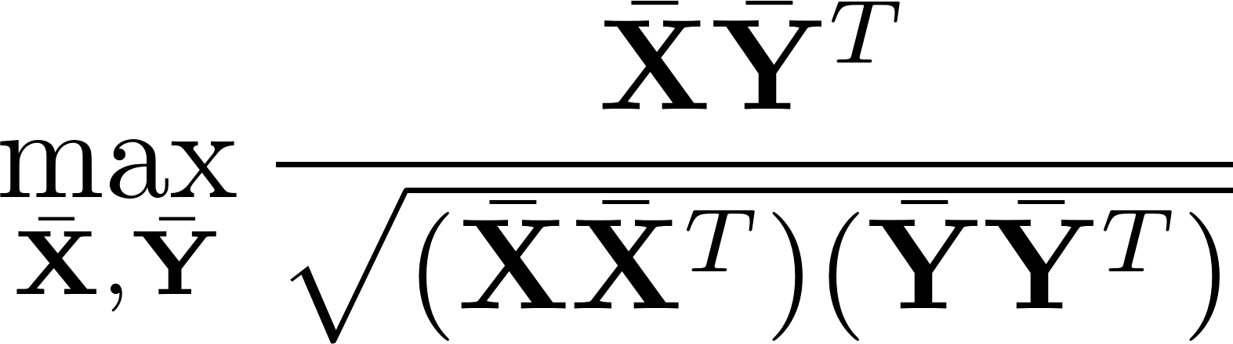
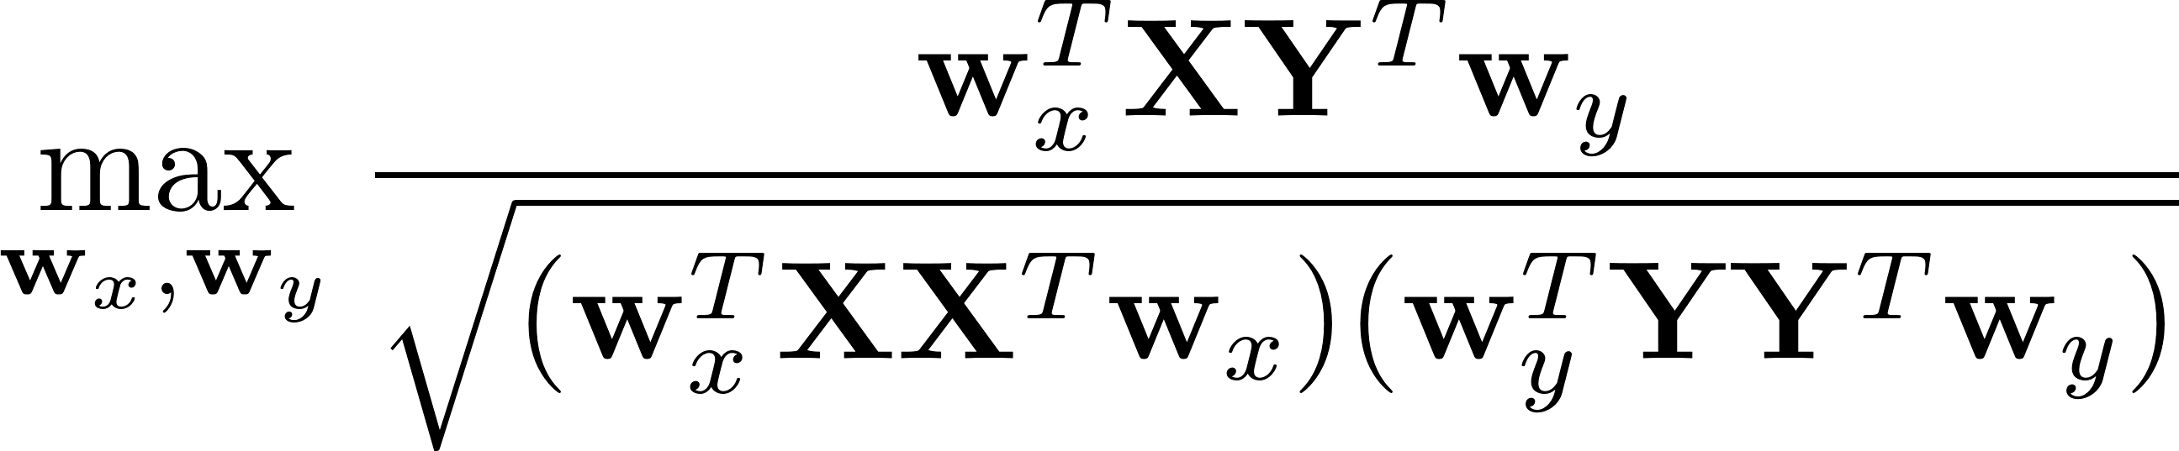
Canonical Correlation Analysis (CCA)
1. Decentralize and
2. Learn projection and to maximize the correlation between and

Slide 17
Correlation
What if each sample is a vector with infinite dimension?

Slide 18
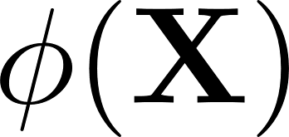
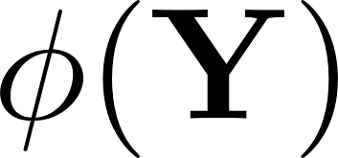
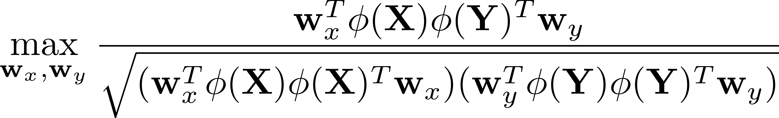
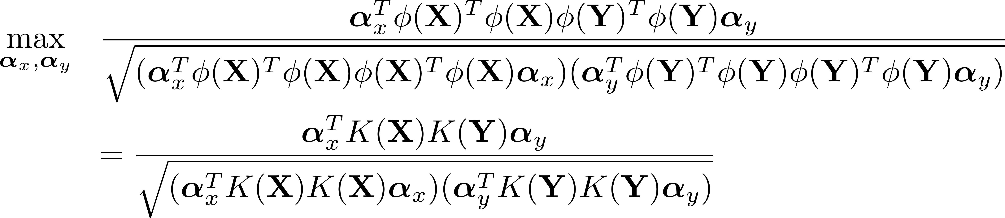
Kernel Canonical Correlation Analysis (KCCA)
For and , we cannot use and
Representation theorem:

Slide 19
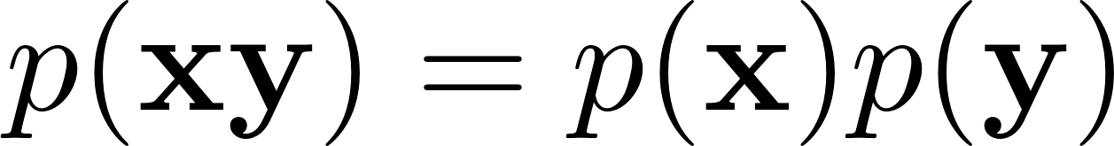
Correlation and independence
Uncorrelation:
Independence:

Slide 20
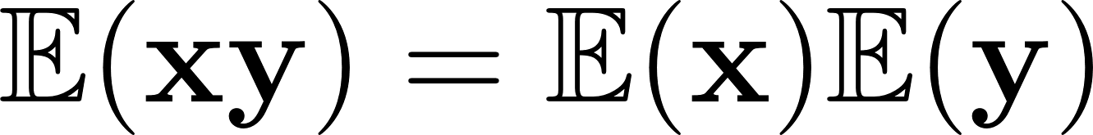


Correlation and independence
Uncorrelation:
Independence:
independence
uncorrelation
uncorrelation
independence

Slide 21
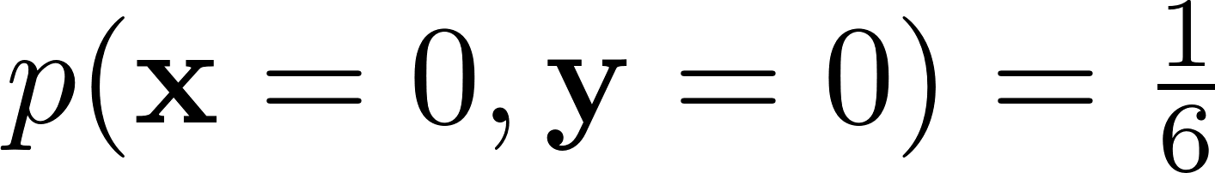
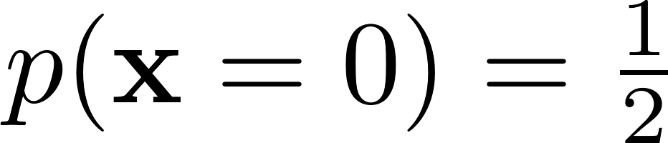
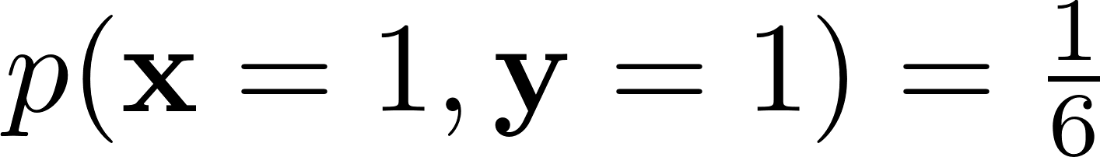
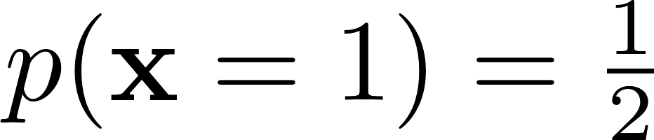
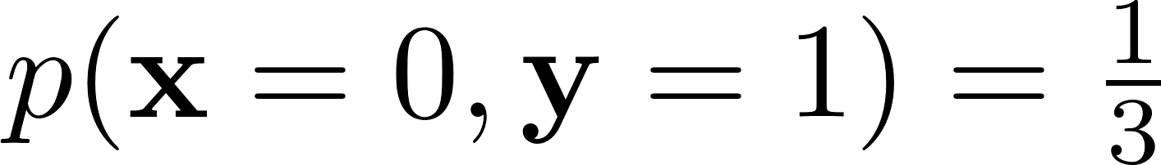
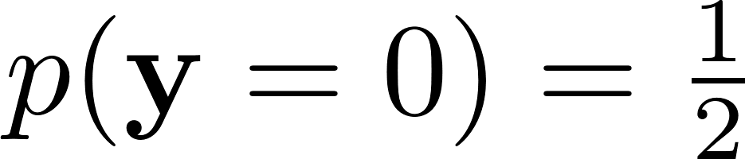
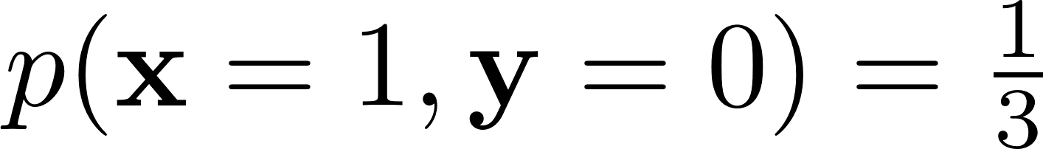
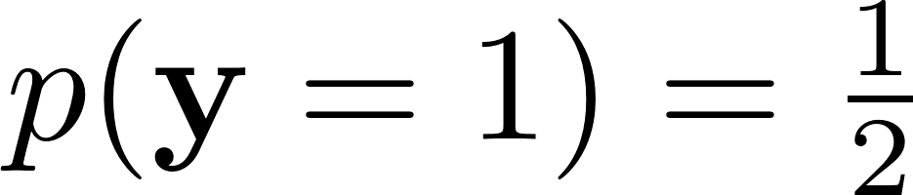
Conditional independence
joint distribution
marginal distribution
x\y | 0 | 1
0 | 1/6 | 2/6
1 | 2/6 | 1/6
x\y | 0 | 1
0 | 1/6 | 2/6
1 | 2/6 | 1/6

Slide 22
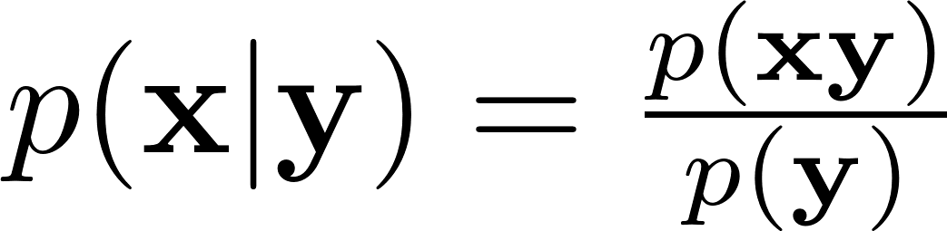
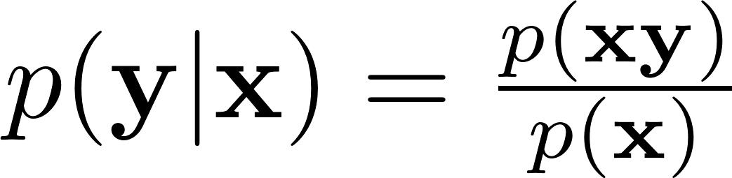

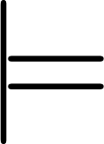

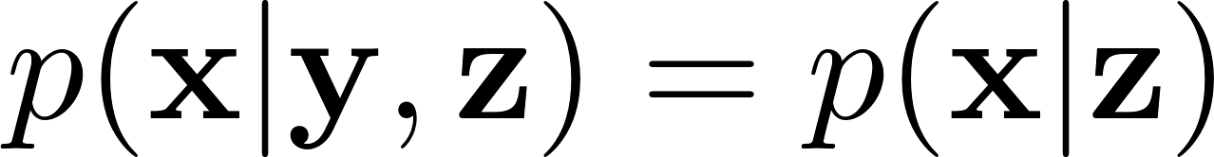
Conditional independence
We say is independent with given , i.e., , if

Slide 23
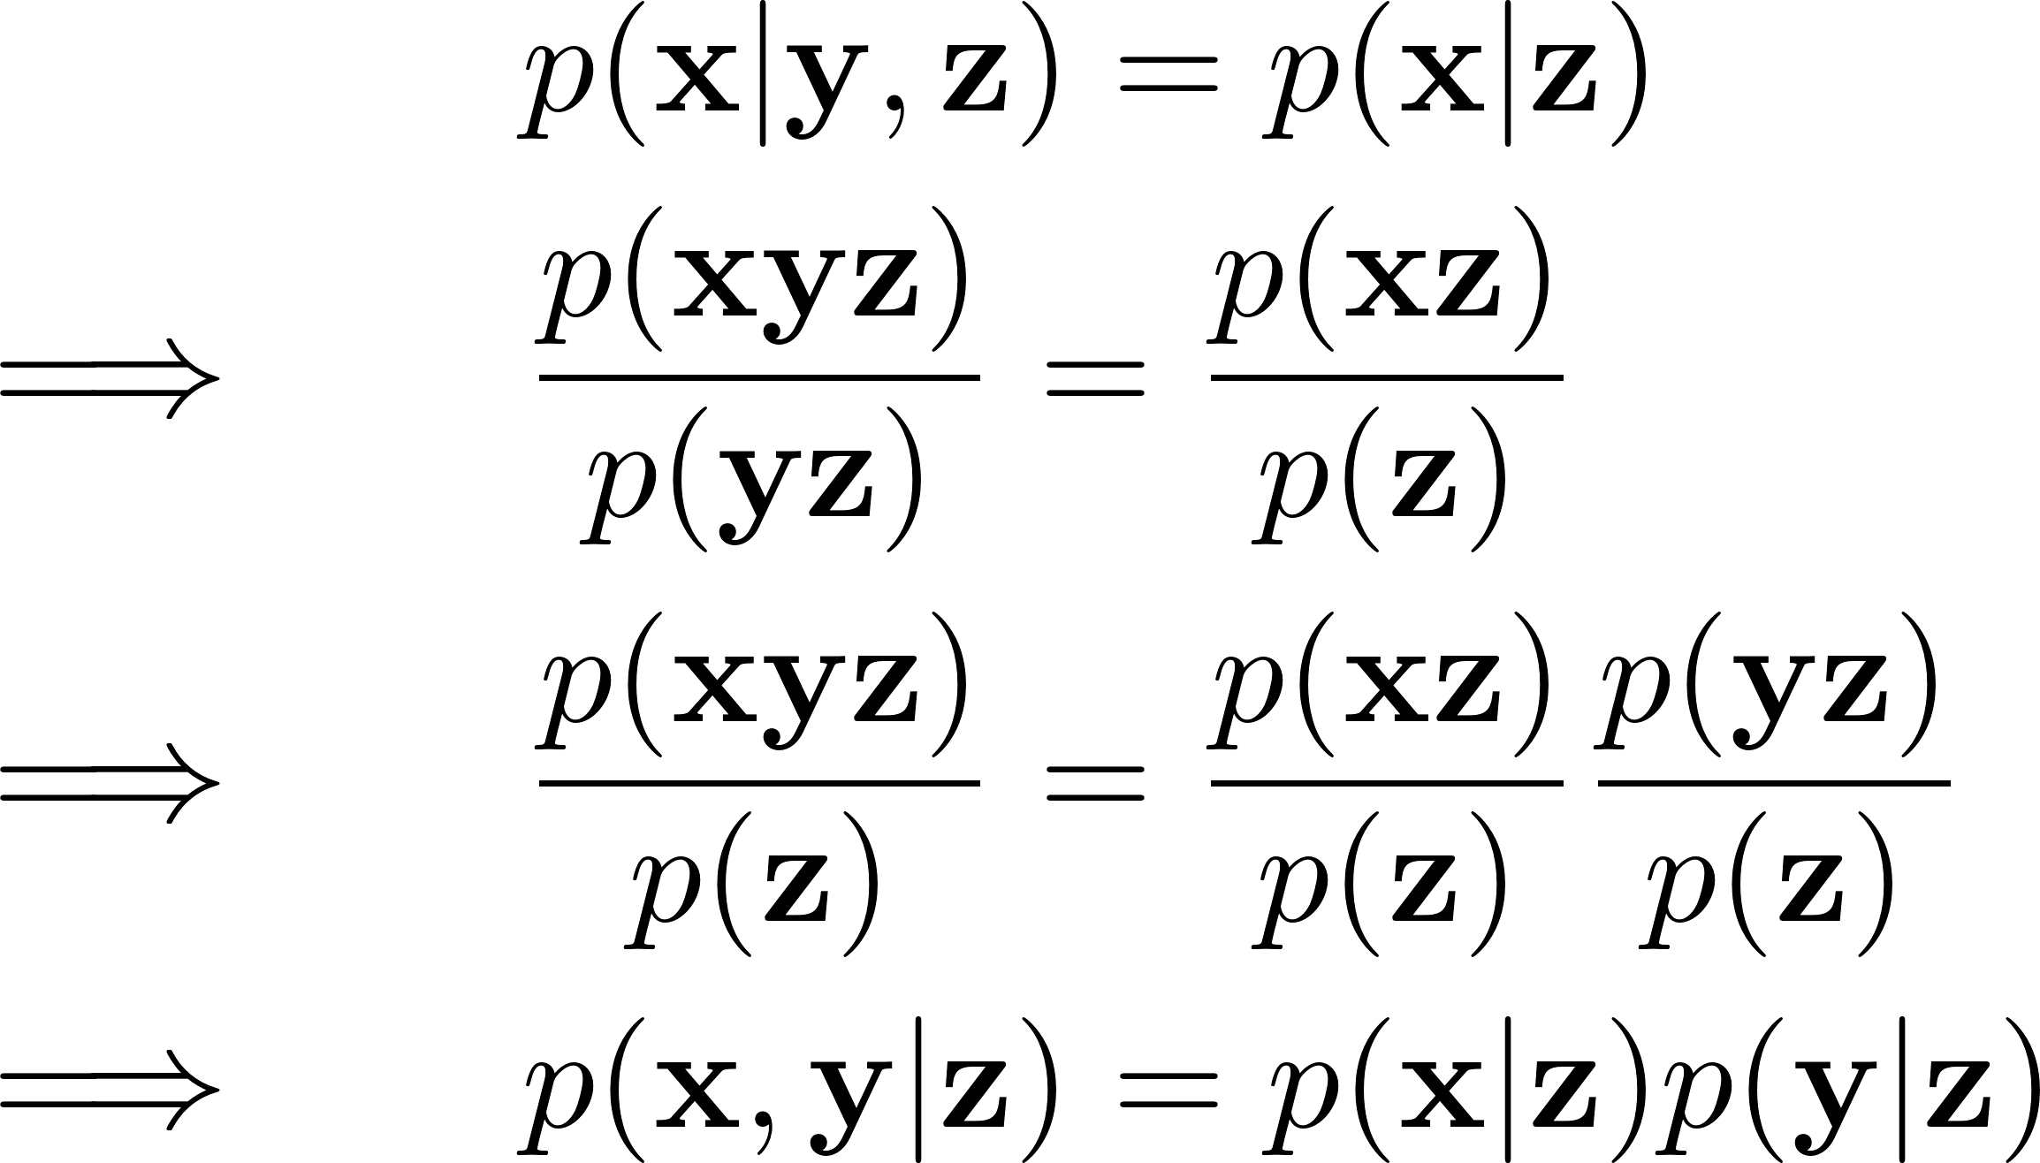
Conditional independence

Slide 24
Correlation
Causation

Slide 25
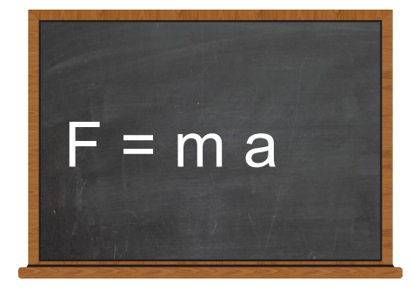
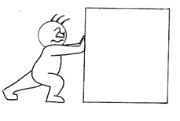
Correlation or causation?
Does acceleration cause the force?
Does the force cause the acceleration?
Does the force cause the mass?

Slide 26
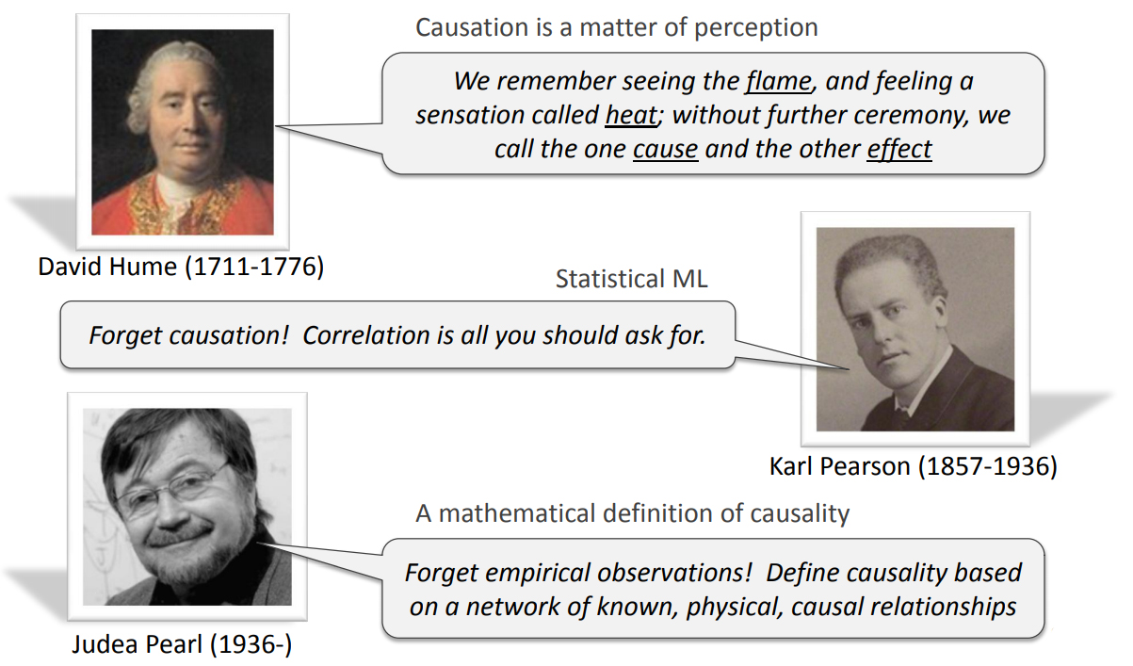
Correlation or causation?

Slide 27
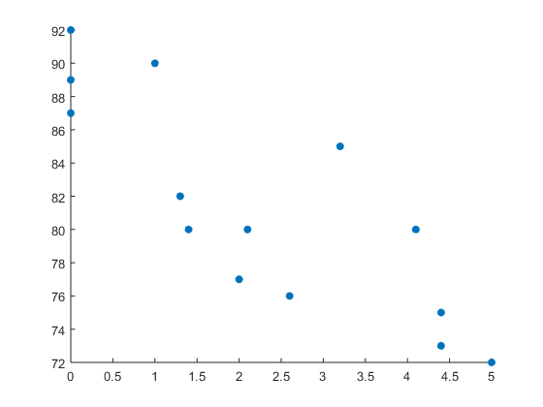
Correlation or causation?
Negative correlation between work performance and hours of watching TV
work performance
hours of watching TV

Slide 28
Correlation or causation?
Hours of watching TV is the cause of work performance ?
hours of watching TV
work performance

Slide 29
Correlation or causation?
Hours of watching TV is the cause of work performance ?
confounding factor
hours of sleep
hours of watching TV
work performance

Slide 30
How to infer causation?
Intervention
Counterfactual

Slide 31
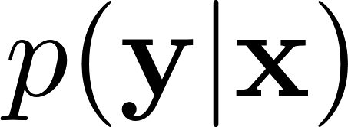
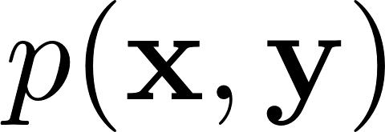
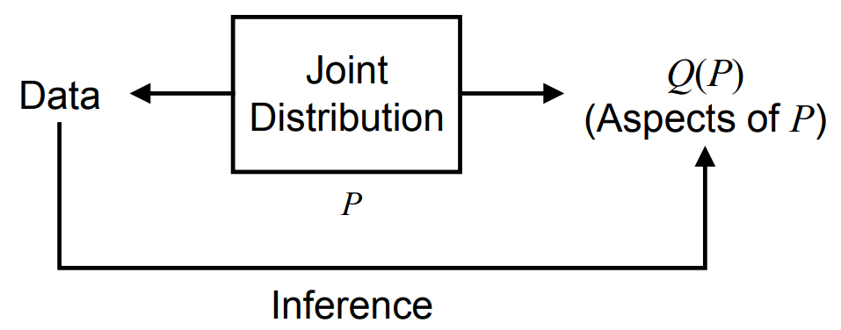
Intervention
What if we see x?
Bayesian network
x\y | 0 | 1
0 | 1/6 | 2/6
1 | 2/6 | 1/6

Slide 32
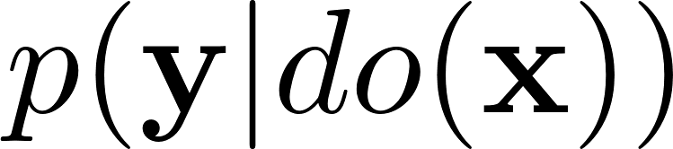
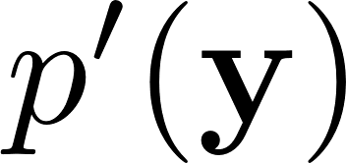
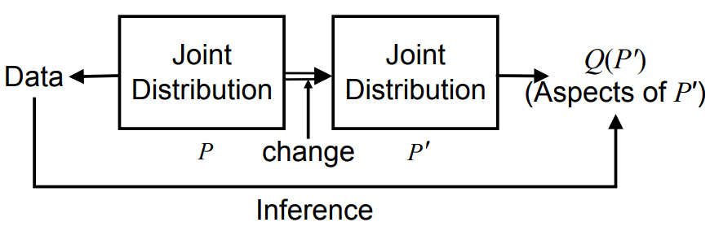
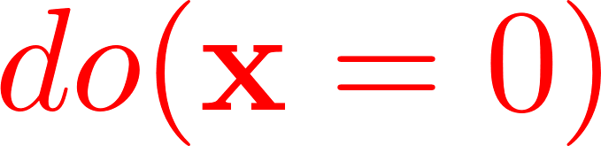
Intervention
What if we do x?
Causal Bayesian network
x\y | 0 | 1
0 | 1/6 | 2/6
1 | 2/6 | 1/6
x\y | 0 | 1
0 | ? | ?
change:

Slide 33
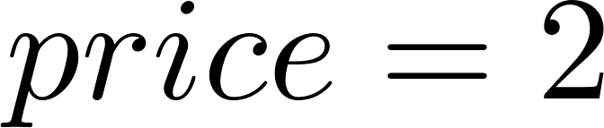
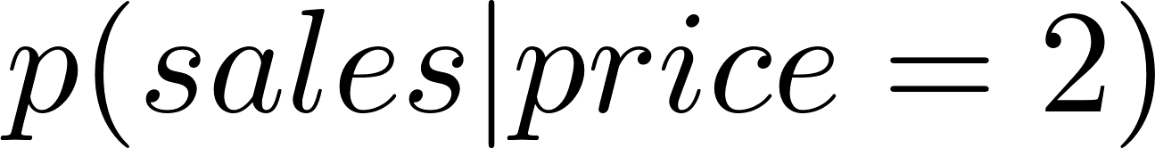
Intervention
What if we see ?
Bayesian network

Slide 34
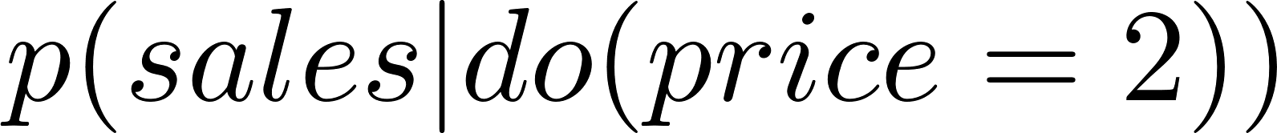
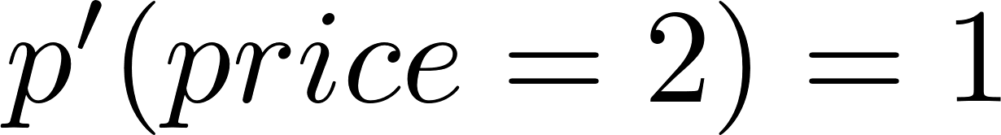
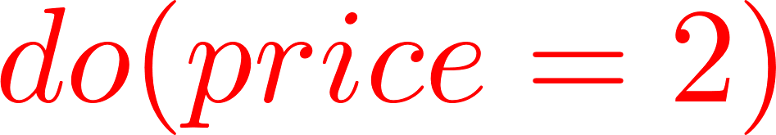
Intervention
What if we do ?
Causal Bayesian network
change:

Slide 35
Intervention
What if we do ?
Causal Bayesian network
Doubling price ≠seeing the price doubled
Estimate the sales when we were to double the price.
change:

Slide 36
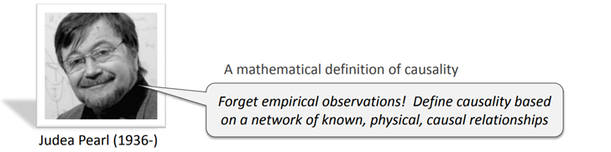


Slide 37
Causation
is a cause of :
is a direct cause of relative to iff

Slide 38



Counterfactual
A: Alice throws a rock at a bottle
B: Bob throws a rock at a bottle
Y: The bottle breaks
A bottle breaks if either Alice or Bob throw a rock at it.

Slide 39



Counterfactual
If not X, then not Y: X is the counterfactual cause of Y
?
?

Slide 40




Actual cause
A variable is an actual cause of an effect if there exists a contingency that makes counterfactual for .
is an actual cause of under the contingency
When B=0,

Slide 41









Responsibility
Responsibility measures the contribution of a cause to an outcome
: contingency set
Example:
is a counterfactual cause of
is an actual cause of , with contingency
When ,

Slide 42
Thanks!

